Slide 1
Project: P3 - Interactive Lifecycle Documentation Development System
Lead: Jeremiah Butler
Members:
Peter Magalhaes
Ari Ushani
Kevin Palmer
Notes:
Peter Magalhaes
Ari Ushani

Slide 2
Project Overview
Problem Description (in your own words)
NUWC is using Microsoft Word to create and modify lifecycle documents, along with a spreadsheet to manually track each requirement throughout the design, development, and testing phases. The problem is that many existing systems available are expensive, complex, and require a database for tracking requirements. NUWC can’t afford the overhead required by large projects and comprehensive systems when developing small to average-sized projects.

Slide 3
Project Overview
Key Technical Challenges
developing a mechanism to track requirements within multiple documents throughout design, development, and testing
provide an adequate GUI for every type of user, including a novice user, to use the system
quickly providing the user with an auto-generated requirements traceability matrix for easy navigation between documents, which is developed solely by the team without influence from the customer
exporting the information into an interactive HTML or PDF using an XSLT processor and schema developed by the team

Slide 4
Technical Approach
After interviewing our customer, and agreeing on possible requirements, we realized we needed to provide a very light, easy-to-use platform, that is not currently available elsewhere. This platform needs to run in Internet Explorer running Windows 7, and our ultimate decision was to create a browser-based application capable of creating and modifying interactive Lifecycle documentation. Since this application runs in Internet Explorer, it will be:
cross-platform compatible - can run on any operating system capable of running select browsers
require no install - there is no need to create a formal installation, which may violate the Navy’s security standards when creating registry keys
user-friendly - allowing the user to easily navigate through documents and make modifications
provide form-like interface - since our user is not familiar with XML, and how it works, we are hiding the XML code behind our graphical interface to avoid errors created by the user manually editing the XML

Slide 5
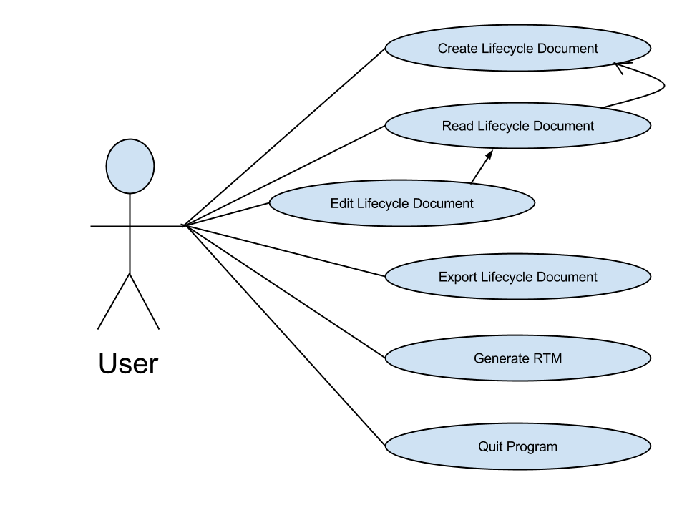
Software Development Process - SCRUM
Planning Sprint (9-13 thru 10-20)
ETC = 20 hours ATC = 15 hours
Contact Customer
Create Vision Document
Start Modeling Use-cases
Research new technology
Retrospective: This introductory sprint was generally to get the entire team onto the same page and working in unison. We realized the tools we were using were not up specifications required by the course, and other scrum tools very difficult and not very user friendly.

Slide 6
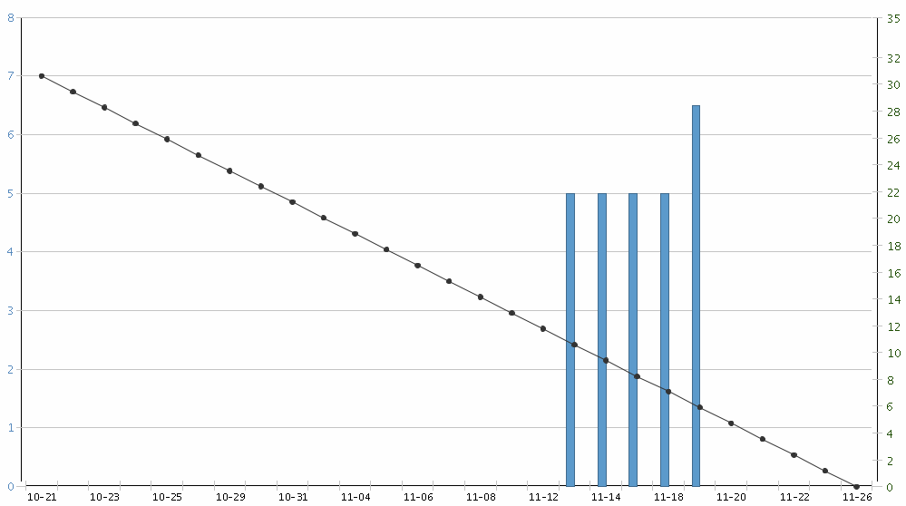
Software Development Process - SCRUM
Design Sprint (10-21 thru 11-27)
ETC = 10 hours ATC = 5 hours
Update Vision Document
Create Software Development Plan
Create Software Requirements Specification
Retrospective: With a couple of planned meetings with our customer completed, we had a good idea of the project direction. Along with modeling, these meetings helped us a lot to prepare for development of the project. However, our scrum tools were still not up to par, but we finally decided to stick with Rally Development.

Slide 7
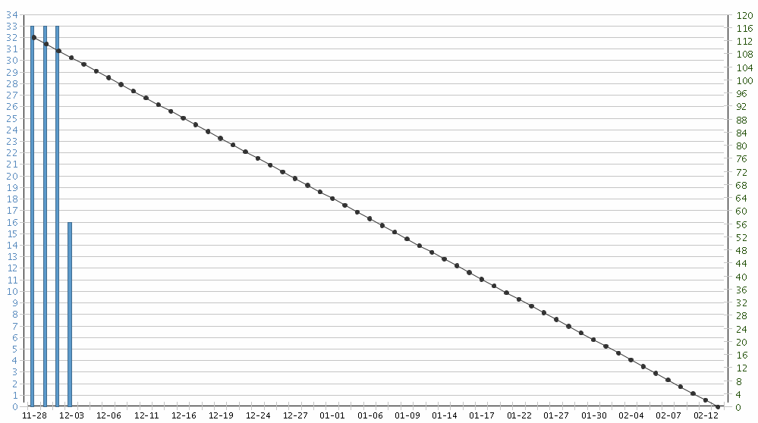
Software Development Process - SCRUM
Creation Sprint (11-28 thru 2-14)
ETC = 25 hours ATC = TBD
Implement new technologies
Create XML Schema
Create Requirements Traceability Matrix
Create Prototype
Retrospective: Our coders realized that having a much better knowledge of the programming languages would help better in this sprint. The models we created in earlier sprints worked well to define project direction, but should be a lot more comprehensive by the end of this sprint.

Slide 8
Software Development Process retrospective
Interaction with customer
Our first meeting on Sept. 26th, we met Michael in-person on 3rd floor Dion. We discussed his ideal project direction and ultimate goal. We learned that he needed a complete system to allow a user to create, and modify XML documentation, without prior knowledge of XML.
The next two meetings with Michael during October in the library, were very informational in regards to how XML functions. Michael also provided an in-person demonstration of how an old and outdated system was used, and provided a presentation on XML, which gave us a more in-depth understanding of how the system was going to be used.
The last meeting with Michael on Nov. 7th, we discussed the project progress. We also presented quite a few models, XML templates, and pencil drawn user interfaces with Michael to gauge our understanding and acquire more knowledge about the project goals.

Slide 9
Software Development Process retrospective
Jeremiah - Team lead, Developer
accountable for the overall project completion as a lead developer and team manager
Peter - Communications, Designer, Organizer
provides a contact point for our customer and helps coordinate team with organization of material in a timely manner
Kevin - Quality Control, Documentation
creates and populates the required documentation in accordance with the team collaboration and project direction
Ari - Developer, Designer
handles coding and visual display of the project, also works to assist the team lead with various tasks

Slide 10
Software Development Process retrospective
Miscommunication in use of SCRUM tools at beginning of semester mislead the group into using multiple SCRUM tools. After using SCRUMDo and Trello, we finally decided to stick with Rally Software Development only because it provided time of completion in it’s stories and illustrated a burndown graph for each iteration.
Sprint Iteration Burndown is inaccurate due to the team utilizing multiple SCRUM tools before finally devoting to Rally.
Frequent team meetings, and multiple meetings allowed the team to interact with the customer and gather a lot of information regarding the project. With each recurring meeting, the team learned more, and made new discoveries from customer interaction. Our NUWC advisor is very flexible when scheduling meetings here on campus.
Third Party IDE “Koding”, initially was very buggy, but has since then greatly improved and is being utilized by the team to collaborate with code.
Google Drive allows the groups to share all other documentation and material in a cloud for easy retrieval on campus and allows the team to work simultaneously in a particular document. This is used in combination with GitHub to store all the groups material.

Slide 11
Software Development Tools
Describe all tools being used
Version and Source Code Control (and backup)
Github - web-based revision control system for software development projects that also provides a repository (ie. code)
Google Drive - file-storage and synchronization provided via a cloud storage which is excellent for the team to collaborate and work simultaneously on a document (ie. similar to Microsoft Office)
Standardized development environment (IDE)
Koding - online software development environment that allows developers to program in multiple languages and collaborate inside an internet browser without the need for a software development kit

Slide 12
Software Development Tools
Scrum Tools
Rally Software Development - an application lifecycle management software that provides a cloud-based solution to manage software development by providing an interface to plan, track, and automate the software development process
List of 3rd party libraries
jQuery - free and open source multi-browser library that was designed to simplify client-side scripting, making it one of the most widely used Javascript libraries
XMLHttpRequest - offers an application program interface to be used with Javascript, this allows for simple interaction with XML documents. Incoming data can be used to alter the current document in the browser window without loading a new page

Slide 13
Demonstration
Prototype / GUI

Slide 14
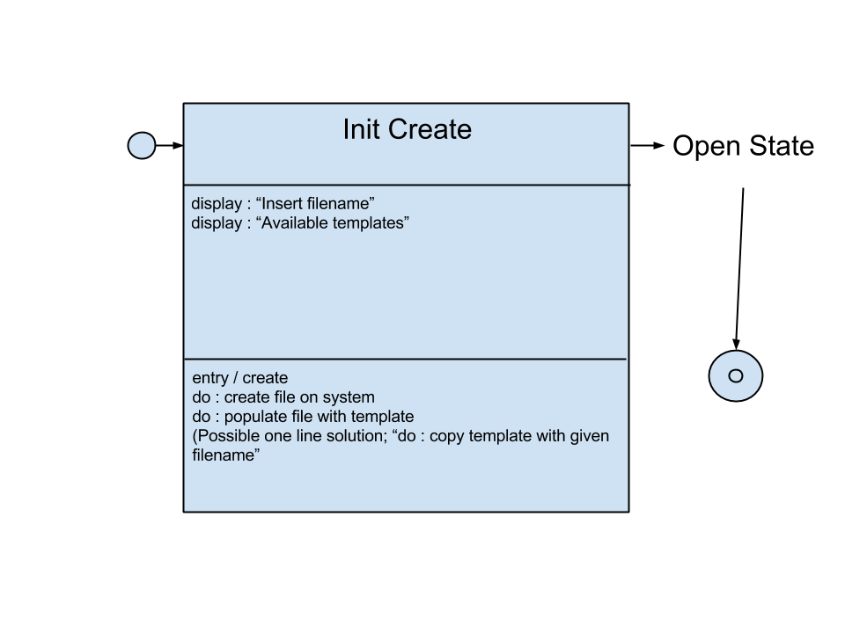
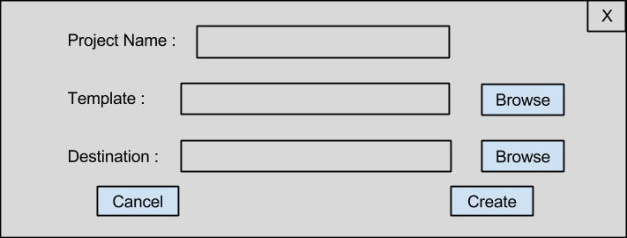
Creating a Project

Slide 15
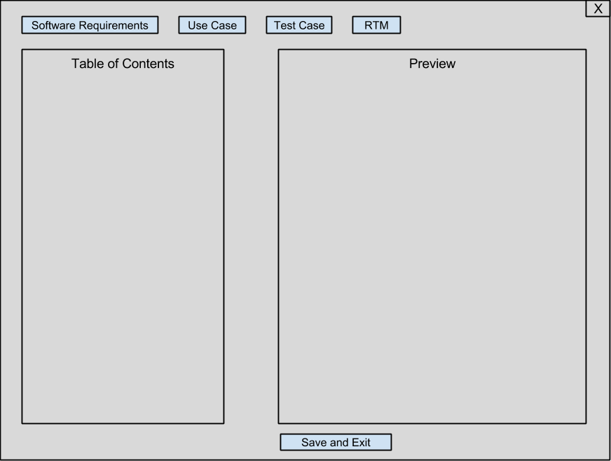
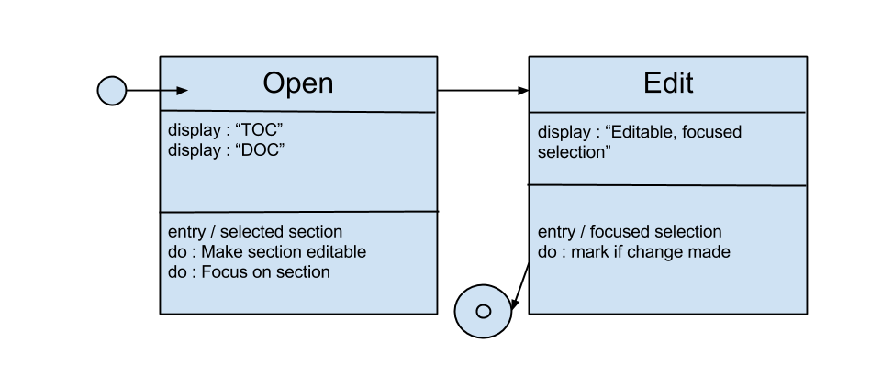
Editing a Project

Slide 16
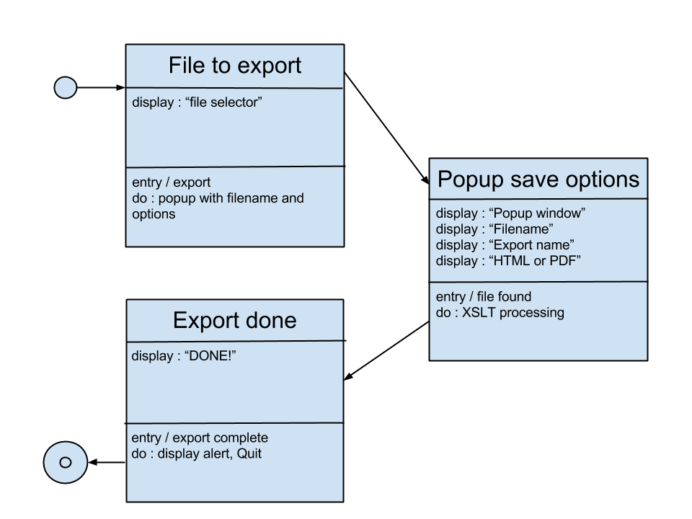
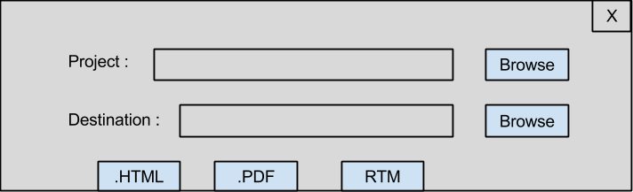
Exporting a Project

